Slide 1
ROUTES OF DRUG ADMINISTRATION
DR.ULFAT SULTANA
PROFESSOR
PHARMACOLOGY MCM

Slide 2
Objectives
Enlist various routes of drug administration
Describe the advantages & disadvantages of various routes of drug administration
Apply the principles of different routes of drug administration in relation to clinical application.
Describe First Pass effect.

Slide 3
First Pass Effect
The metabolism of a drug before reaching the systemic circulation.

Slide 4
First Pass Effect
GIT
Portal circulation
Liver (Main site)

Slide 5
Route of administration:
A route of administration is the
path by which a drug, fluid, poison
or other substance is brought into contact with the body.

Slide 6
Types of Routes of Administration
The possible routes of administration are
divided broadly into three classes:
  Enteral
  Parenteral
  Topical
  Inhalational

Slide 7
1. ENTERAL ROUTES
Sublingual
Buccal
Oral
Rectal

Slide 8
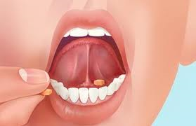
Sublingual
Held under the tongue (sublingual tablet)
Importance:
( enter the systemic circulation directly
through the sublingual vessels)
E.g Nitroglycerin, as a softer sublingual tablet may be used for the rapid relief of angina.

Slide 9
Advantages of sublingual route:
Avoid hepatic first pass – Drainage is through superior vena-cava ; thus the liver is by-passed.
Rapid absorption - Because of the good blood supply to the area.
Drug stability - pH in mouth is relatively neutral (7.4). Thus a drug may be more stable.

Slide 10
Disadvantages of sublingual route:
Inconvenient
Unpleasant taste of some drugs
Small doses

Slide 11
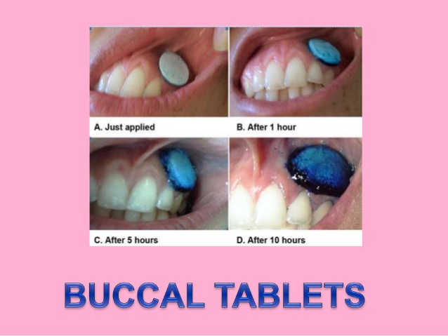
Buccal route
Drug is placed b/w the gums and inner lining of the cheek.

Slide 12

oral route:
  Advantages:
  Natural & most convenient route
  Suitable for self administration
  Used for local as well as systemic effects
  of drugs
  Large area is available for absorption

Slide 13
  Disadvantages:
Destruction of drugs by digestive enzymes (e,g insulin)
First pass effect: Metabolism of dugs by enzymes
Slow onset of action (not suitable for emergencies)
Cannot be used in unconscious patients

Slide 14
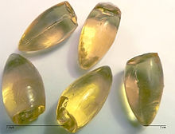
3. Rectal Route:
The drug may be placed in the rectum in
the form of:
  Suppositories
  Enema
About 50% of the drug absorbed from
rectum will bypass the hepatic first-pass imp.viva quest
metabolism.
Blood supply to rectum:
Superior rectal vein - - empties into portal vessels
Middle and
Inferior rectal vein - - empties into systemic vessels

Slide 15
RECTAL ROUTE
Advantages:
50% of the absorbed drugs by-pass hepatic
first pass metabolism.
Can be used in unconscious patients, elderly,
children
Nauseous or vomiting patients
Good for drugs affecting the bowel -- laxatives

Slide 16
RECTAL ROUTE
Disadvantages:
Many drugs may cause irritation of rectal mucosa
Could be embarrassing for the patient

Slide 17
Question-1
Q-1 Enlist the advantages of sublingual route.

Slide 18
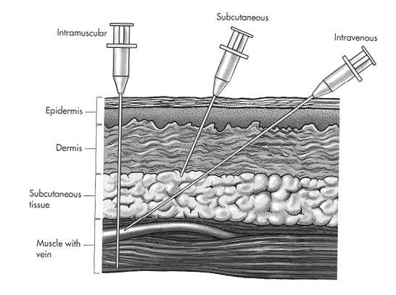
Parenteral Routes
Parenteral injections:
  Intravascular = Intravenous / intra-arterial
  Subcutaneous
  Intramuscular
  Intradermal

Slide 19
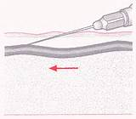
INTRAVenous route: (drugs are injected into a vein )
  Advantages
  100% bioavialibility
  Irritating solution can be given
  Large doses can be given
  Suitable for Emergencies and Unconscious patients

Slide 20
INTRAVenous route:
  Disadvantages:
Unfavorable reactions are likely to occur due to
increased concentration;
Expert person is needed;
Risk of embolism / infection

Slide 21
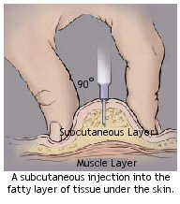
Subcutaneous Injections:
Sites: Abdomen, Thighs
Advantages:
  Slow and constant absorption
  Insulin is given mainly through this route
  Disadvantages:
  Only small amount of drug is given (Doses > 2ml are not given by this route)

Slide 22
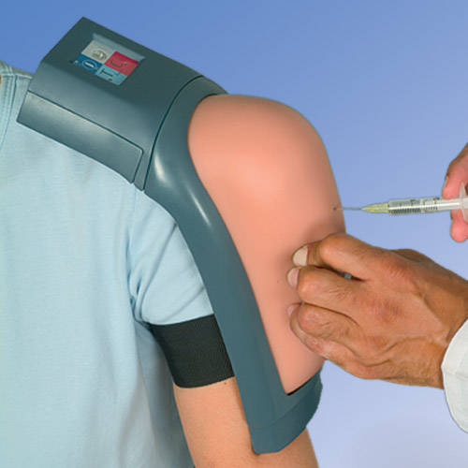
Intramuscular Injections:
Drug is injected into the skeletal muscle.
Advantages:
  Rapid absorption of drugs (aqueous solution)
  Large amount of drug (>5ml) is given by this route
  Low chances of sepsis as compared to S/C route
Disadvantages:
  Local pain and inflammation

Slide 23
Question-2
Q-2 Enlist the advantages of intravenous route.

Slide 24
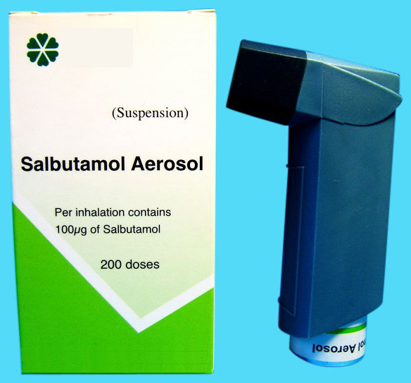
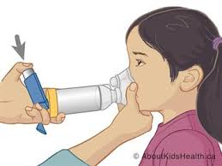
Other Routes of Administration:
Inhalational Route:
Means administration of drug
Through respiratory passages
Advantages:
Rapid onset
For local effects
Maximize benefit
Minimize side effects
First pass effect is avoided
Disadvantages:
Special apparatus is needed

Slide 25
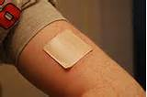
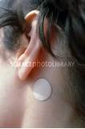
Transdermal route:
  Some drugs are applied to the skin for
  their systemic effect
      Scopolamine (hyoscine), for motion sickness
      (patch placed behind the ear )
      Many hormones (– estrogen )
  Advantage:
  Drugs do not undergo hepatic first-pass
  metabolism
  Disadvantage:
  Absoprtion is slow

Slide 26
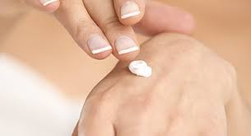
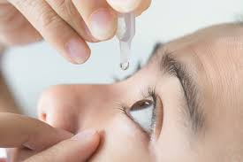
Topical route:
  Drugs are applied to the skin or mucous membrane for
  their localized actions.
  e,g cream, ointment, lotion, powder, eye drops,
  Advantage:
  Local therapeutic effects
  Less adverse effects
  Disadvantage:
  Not well absorbed in to the deeper layers of skin and mucous membrane

Slide 27
Question-3
Q-2 Enlist the advantages of inhalational route.

Slide 28
summary
Routes of administration
Enteral 2. Parenteral 3. Topical 4. inhalational
Enteral :
Oral: Safe & painless but having greater 1st pass effect & slow onset of action
Sublingual
Rectal

Slide 29
Summary (contd)
Parenteral:
1. Intravascular: route of choice for emergencies but has greater risk of infections
2. Intramuscular
3. Subcutaneous:
Transdermal: Avoids 1st pass effect
Inhalational: rapid onset of action & good for local effects

Slide 30
Route of administration -Time until effect
intravenous 30-60 seconds
inhalation 2-3 minutes
sublingual 3-5 minutes
intramuscular 10-20 minutes
subcutaneous 15-30 minutes
rectal 5-30 minutes
oral 30-90 minutes
transdermal (topical) variable (minutes to hours)
(Intravenous> inhalational> sublingual>intramuscular)

Slide 31
Routes which bypass the first pass effect are
Sublingual
Intravenous
Intramuscular
Subcutaneous
Rectal (partial)
Inhalation
Transdermal

Slide 32

Thank You

