Slide 1
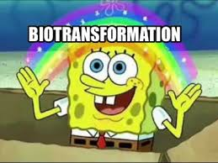
Dr ULFAT SULTANA

Slide 2
Objectives :
By the end of the discussion , you shall be able to :
Describe biotransformation .
Describe xenobiotic .
Describe phases and reactions of biotransformation and the factors affecting it .
Describe major drug metabolizing enzyme systems .

Slide 3
Describe Enzymes induction and enzyme inhibition and it’s significance .
Describe suicide inhibition .
Discuss first pass effect.
Discuss enterohepatic circulation .

Slide 4
BIOTRANSFORMATION :
Drugs undergo changes when processed by enzymes in the liver.
Chemical alteration of drug in the body is called biotransformation.
Non polar , lipid soluble compounds are converted to polar lipid insoluble , so that they are easily excreted .

Slide 5
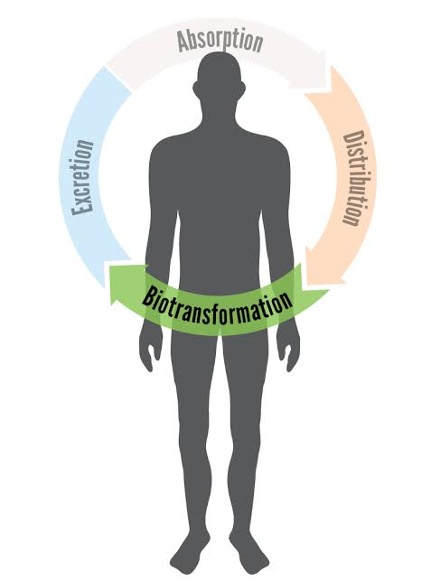

Slide 6
SITES :
Primary site is liver but may involve other sites such as kidney , lungs , skin etc
GIT – Tyramine
Lungs – Procainamide , Prostanoids
Plasma – Suxamethonium

Slide 7
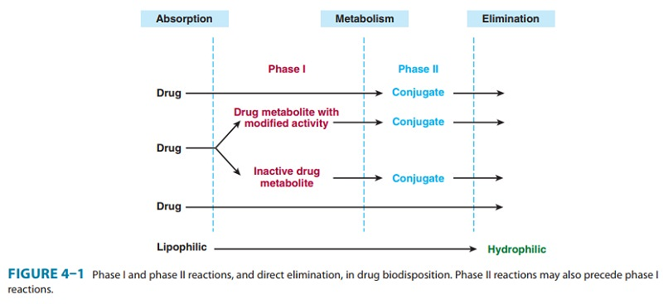

Slide 8
CONSEQUENCES :
1- DRUG ACTIVATION - activation of prodrug to active drug .
Prodrug is an inactive form of drug which is converted to an active form after metabolism.
Levodopa ( inactive) – dopamine ( active )
Prednisone – prednisolone .
2 -DRUG INACTIVATION – inactivation of drug .
Phenobarbitone –hydroxyphenobarbitone
Phenytoin – p-hydroxyphenytoin

Slide 9
3- ACTIVE DRUG TO ACTIVE METABOLITE -
Chloroquine – hydroxychloroquine
Diazepam – oxazepam
Codeine – morphine
4-ACTIVE DRUG TO TOXIC/MORE ACTIVE METABOLITE :
Halothane - trifluoroacetic acid

Slide 10
Xenobiotic
All day long, we are taking in substances that are transformed by the body for its use. We inhale air, from which we absorb oxygen. We take in water, food, chemicals (both good and bad), and drugs(both good and bad). These substances are called xenobiotics because they are not produced by the body but are found in the environment in which we live.

Slide 11
FIRST PASS EFFECT :
Pre-systemic metabolism of drugs given by oral route .
Metabolism of drug during its passage from site of absorption into systemic circulation .
As the drug passes through mucosal cells , it’s metabolized on passage through gut wall and mainly in liver , so very little quantity of parent drug reaches circulation .

Slide 12
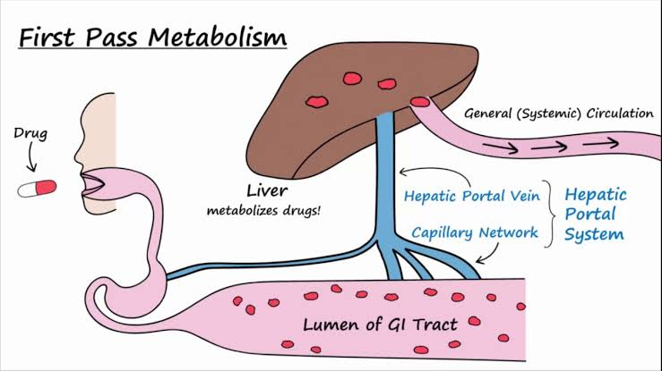

Slide 13
Drugs that undergo first pass effect :
Morphine
Propranolol
Glyceryltrinitate
In liver cirrhosis , the first pass effect is reduced and bioavailability of drug is increased and may cause toxicity .

Slide 14
Routes that bypass first pass metabolism :
Sublingual
Intravenous
Intramuscular
Inhalational aerosol
Per-rectal

Slide 15
Hofmann Elimination :
ELIMINATION is a mechanism of removing the active form of a drug from the body.
Drugs which are metabolized in plasma through molecular rearrangement without involvement of enzyme action.
e.g,. atracurium besylate (skeletal muscle relaxant).
Atracurium is a quarternary amino compound that is transformed into a tertiary product.

Slide 16
ENZYMES OF BIOTRANSFORMATION
There are two types of enzymes which take part in biotransformation .
1- Microsomal enzymes
2- Non-microsomal enzymes

Slide 17
1-Microsomal enzymes :
Cytochrome p450 is the main element in the liver’s metabolic process.it is a large family of proteins named cyto for cell, and chrome bcoz of heme or iron factor in enzyme.
This Heme containing enzyme , located in smooth ER of liver is responsible for metabolism of most of the drugs .
CYP450 are classified into families designated by numbers---based on amino acid sequences.
Similarly CYP3A4 is responsible for metabolism of 50% of clinically prescribed drugs in liver .

Slide 18
2-Non-Microsomal enzymes :
These are located in mitochondria and cytoplasm and include :
1- Xanthine oxidase
2- aldehyde dehydrogenase
3- MAO
4- Cholinesterase etc.

Slide 19
Reactions of Biotransformation
Biotransformation of drug occurs by :
1- Phase 1 / Non-synthetic reactions
2- phase 2 / synthetic / conjugation reactions

Slide 20
Phase 1 reactions :
This involves addition or unmasking a functional group (OH , NH2 ) , the resulting metabolite can be active or inactive .
Following reactions are included in phase 1 :
1-Oxidation
2- Reduction
3- Hydrolysis
4- Cyclization
5- Decyclization

Slide 21
Phase 1 Reaction | Examples
1-Oxidation Addition of oxygen or removal of hydrogen | Phenytoin, phenobarbitone, propranolol
2-Reduction Addition of hydrogen or removal of oxygen | Naloxone , methadone, chloramphenicol
3-Hydrolysis Drug is split combining with water | Procaine , lignocaine , Succinylcholine
4-Cyclization Formation of ring structure from a straight chain compound | proguanil
5-Decyclization Opening up of ring structure of the cyclic drug | Phenytoin , phenobarbitone

Slide 22
Phase 2 Reactions :
These include conjugation of drugs with endogenous radicals .
Resulting metabolite is usually inactive , highly polar and passed in urine or bile .

Slide 23
 | REACTIONS | EXAMPLES
1- | Glucoronide conjugation | Morphine, diazepam
2- | Acetylation | INH ,Hydralazine
3- | Methylation | Histamine , adrenaline
4- | Sulphation | Acetaminophen, Methyl dopa
5- | Glycine conjugation | Nicotinic acid
6- | Glutathione conjugation | Paracetamol
7- | Glutamine conjugation | PAS

Slide 24
Factors affecting Biotransformation :
1-Environment Factor :
cigarette smoke increases metabolism of paracetamol , theophylline , benzodiazpines .
2-DIET :
Certain food items may activate or inhibit CYP450 enzymes and may effect metabolism of drugs .

Slide 25
3- Nature and Dose of drugs :
Toxic doses may deplete enzymes required for metabolism of drugs .
4- Route of administration :
First pass metabolism via oral route decrease bioavailbility .
5-Age
Insufficient hepatic enzymes in neonates may cause toxicity even at therapeutic dose . Grey baby syndrome caused by chloramphenicol

Slide 26
6-Sex :
Males are more prone to sedation from barbiturates and alcohol.
7-Pregnancy :
The rate of metabolism of drugs is greatly affected during pregnancy. Metabolism of Phenytoin and phenobarbitone is increased.

Slide 27
8- Disease :
In Liver diseases reduced hepatic enzymes may cause toxicity of drugs due to decrease metabolism .
Hypothyroidism ~ metabolism of digoxin and methimazole is reduced
In lung diseases , metabolism of procainamide is reduced .

Slide 28
9- Enzyme Induction
Certain drugs on repeated administration may cause hypertrophy of smooth ER , Increase hepatic blood flow and increase synthesis of microsomal enzymes .
This inturn result in increased metabolism of drug and reduced intensity and duration of that drug .
E.g rifampin cause contraceptive failure with co-administered . (MCQ)
Enzyme induction may cause toxicity of drug by forming toxic metabolites e.g. paracetamol poisoning in alcoholics . (MCQ)

Slide 29
10-Enzyme Inhibition :
Certain drugs inhibit the activity of drug metabolizing enzymes , increasing concentration of drug and may result in toxicity .
Inhibition can only occur when both the drugs are metabolized by same enzyme .
E.g
Increased incidence of bleeding with warfarin with co-administration of erythromycin and chloramphenicol .(MCQ)

Slide 30
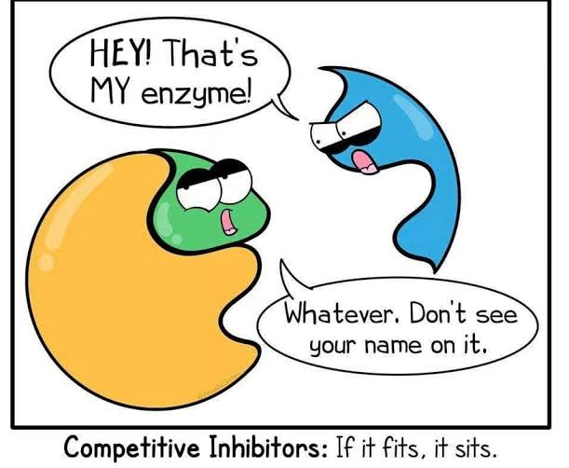

Slide 31
Suicide inhibition :
Also known as suicide inactivation , irreversible inhibition of enzymes that occur when an enzyme binds to a substrate , which forms an irreversible complex through formation of covalent bond , thereby inactivating that enzyme .
Aspirin is suicide inhibitor of cycloxygenase, acting as anti-platelet and blocking PG synthesis .

Slide 32
11-ENTEROHEPATIC CIRCULATION
Circulation of bile salts , bilirubin , drugs and other substances from bile , followed by entry into small intestine , absorption by enterocytes and transport back to liver .

Slide 33
Certain drugs are conjugated by liver and excreted through bile in the intestine , where it is de-conjugated by intestinal bacteria , releasing lipid soluble metabolites . These metabolites are reabsorbed and conjugated by liver and excreted in bile again into small intestine .
This increases the half life of drug.

Slide 34
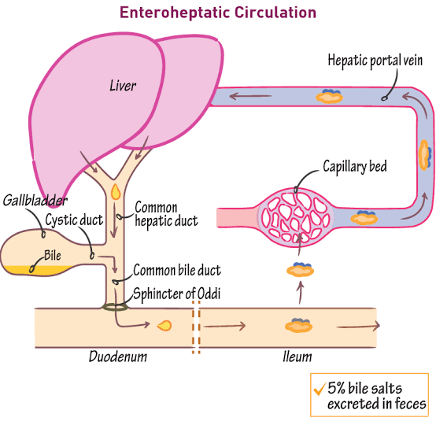

Slide 35
Drugs that undergo enterohepatic circulation
Digoxin
Rifampin
Morphine
Benzodiazepines
Chloramphenicol

Slide 36
12- Genetic factors :
Unique to one’s genes , certain enzymes are deficient in an individual , resulting in decreased metabolism and increased toxicity .
E.g. N-acetyl transferase deficiency may cause toxicity of INH , hydralazine etc (slow acetylators) .
In similar way , genetic increase in activity of certain enzymes reduces the available drug concentration .
E.g. fast acetylators in whom the enzyme metabolizes the drug rapidly .

Slide 37


