Slide 1
Branches of pharmacology , Prescription, OTC, Orphan and WHO essential drugs
Professor Dr Ulfat Sultana
Deptt of Pharmacology
Muhammad College of Medicine

Slide 2
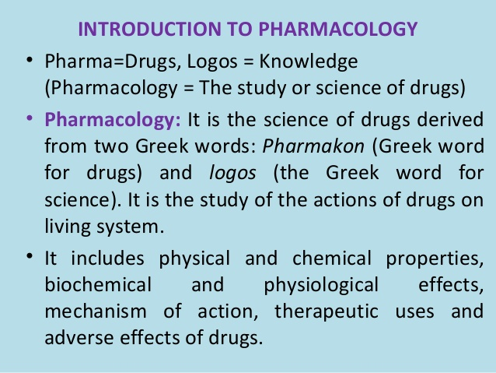
Pharmacology

Slide 3
Basic and clinical Pharmacology
Basic pharmacology: study of effects of drugs on animal tissues or whole animals.
Clinical pharmacology: scientific study of the effects of drugs in humans

Slide 4
Pharmacy
It is the science which deals with the preparation, compounding and dispensing of drugs

Slide 5
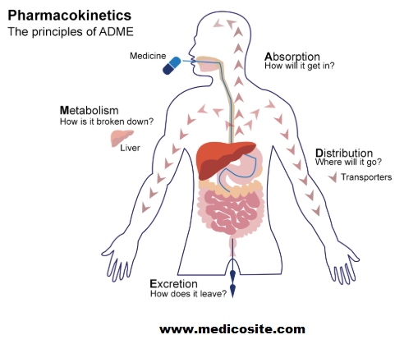
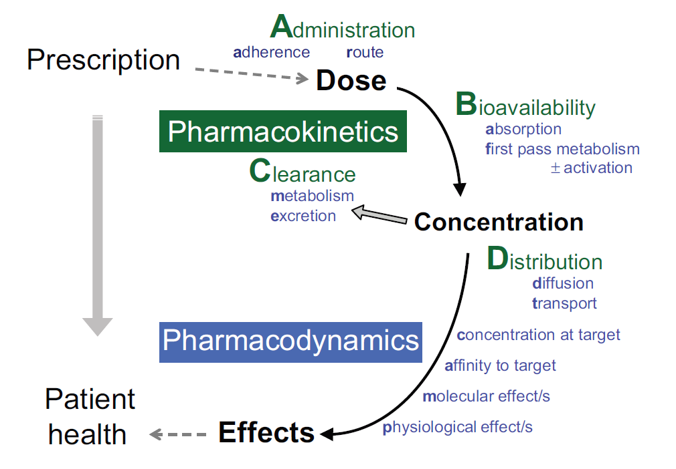
Pharmacokinetics and Pharmacodynamics

Slide 6
Pharmacokinetics and pharmacodynamics
Pharmacokinetics : deals with the absorption, distribution, metabolism and excretion of drugs.(what the body does to the drug)
Pharmacodynamics: mechanism of action and action of drugs (what the drug does to the body)

Slide 7
Pharmacognosy
derived from two Greek words, pharmakon “drugs” and gnosis “knowledge”.
In brief pharmacognosy means “Knowledge of drugs”
identification of drugs
Pharmacognosy is a scientific discipline, which is primarily concerned with the study of crude drugs obtained from natural resources, such as plants, animals and minerals
Examples plants ( morphine, quinine), animals (insulin, heparin) minerals (liquid paraffin) microorganisms (penicillin )

Slide 8
Pharmacotherapeutics
“Practical application of the knowledge of pharmacology in the prevention and treatment of diseases”
Parts of pharmacotherapeutics include:
Selection of the most appropriate drug and dosage
Duration of treatment
Specific features of the patient

Slide 9

Toxicology : The study of how natural and man-made poisons cause adverse effects in living organisms. i.e. mortality, teratogenicity, carcinogenicity, mutagenicity
It involves observing and reporting symptoms, mechanisms, detection and treatment of toxic substances.
All things are poison and nothing is without poison, only the right dose differentiates a poison and a remedy. i.e. opium
Toxicity depends upon dose, physical forms, route of entry, exposure.
It provides protection to humans and environment from toxic effects of toxicants
This study will ultimately lead toward the development of newer, innovative and more selective drug therapies to treat different diseases, such as cancer, having reduced toxic potential to human body.

Slide 10
Posology
Derived from Greek words posos- how much and logos-science
A branch of medical science that deals with dose or quantity of drugs which can be administered to a patient to get desired pharmacological action.
The dose of drug cannot be fixed rigidly because various factors are responsible i.e. age, sex, body weight, severity of the disease, route of administration, synergism, antagonism, metabolic disturbances.

Slide 11
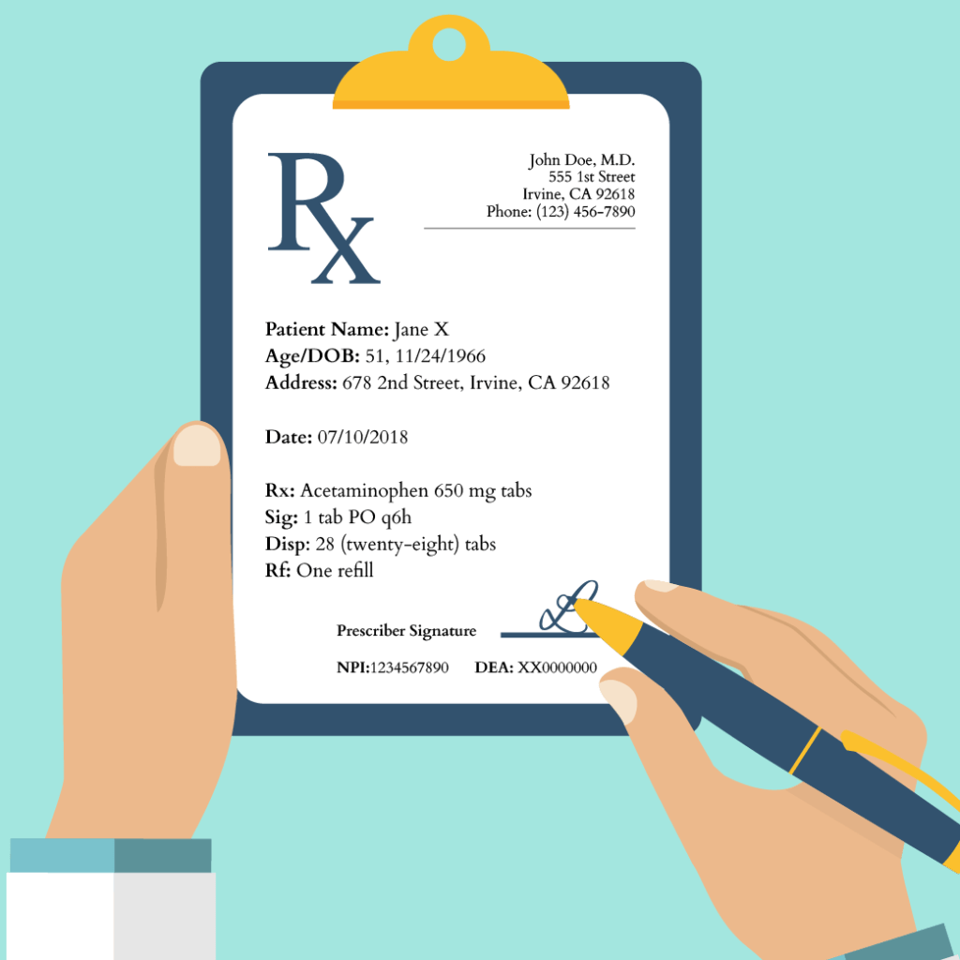
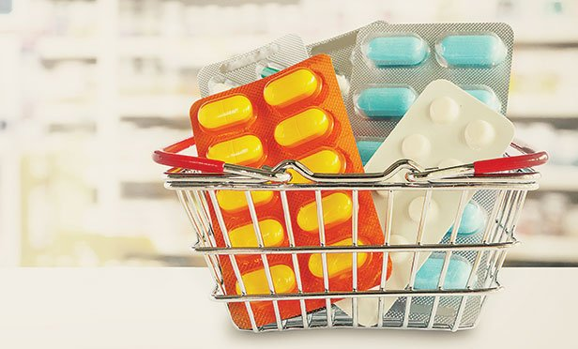
Prescription vs Over the counter drugs

Slide 12
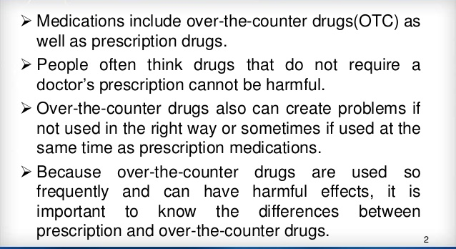
Prescription vs Over the counter drugs

Slide 13
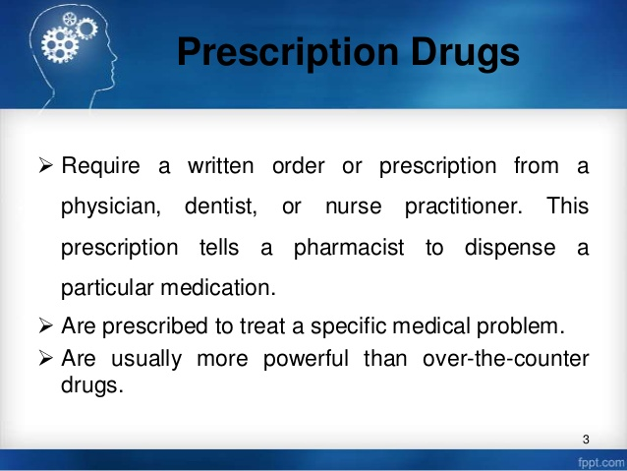
Prescription drugs

Slide 14
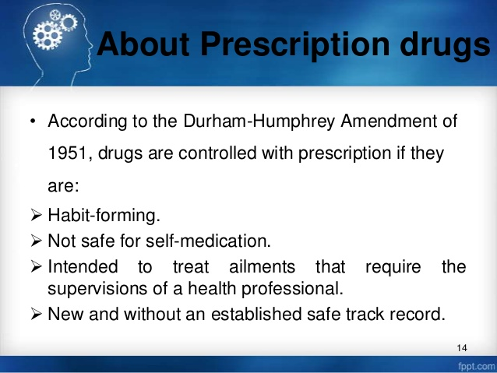
Prescription drugs

Slide 15
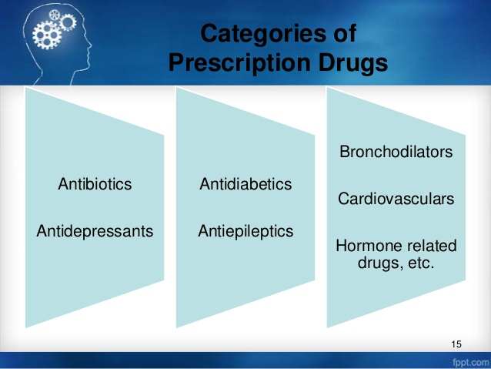
Categories of prescription drugs

Slide 16
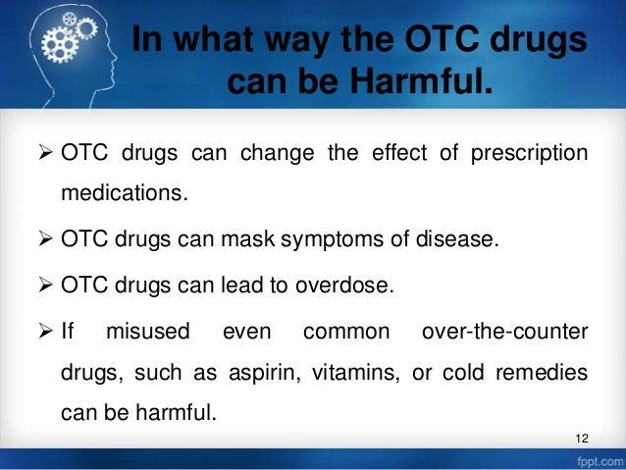
In what way OTC drugs can be harmful

Slide 17
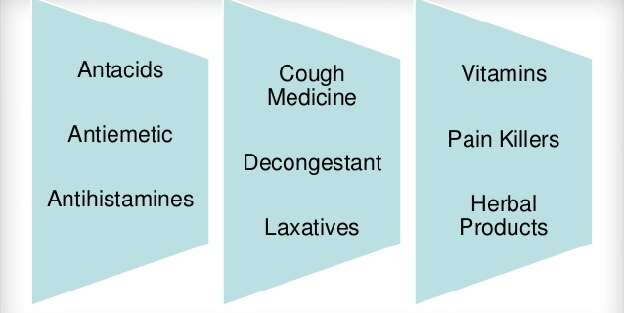
Over the counter drugs

Slide 18
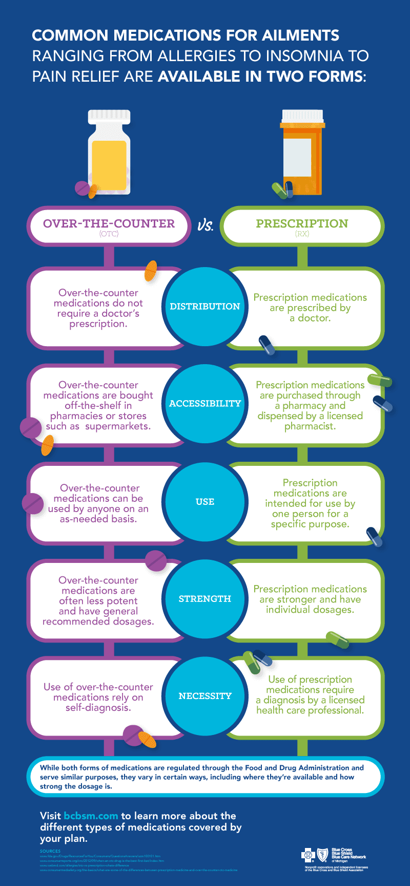

Slide 19
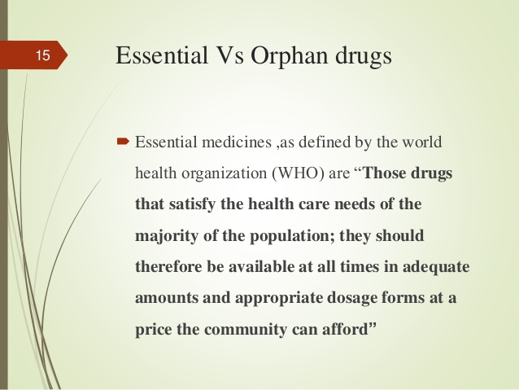
Essential drugs

Slide 20
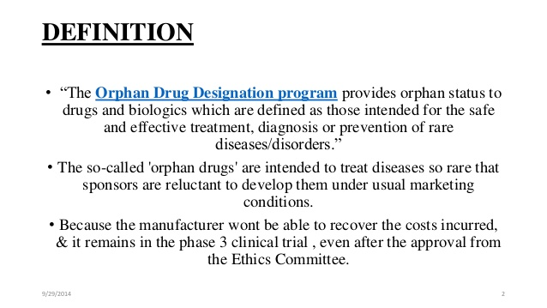
Orphan drugs

Slide 21
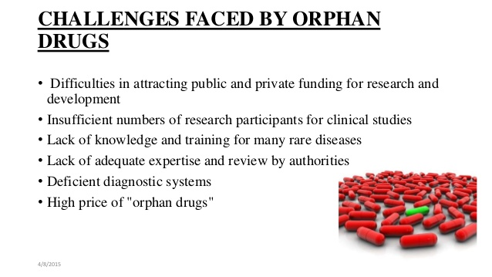
Challenges faced by orphan drugs

Slide 22
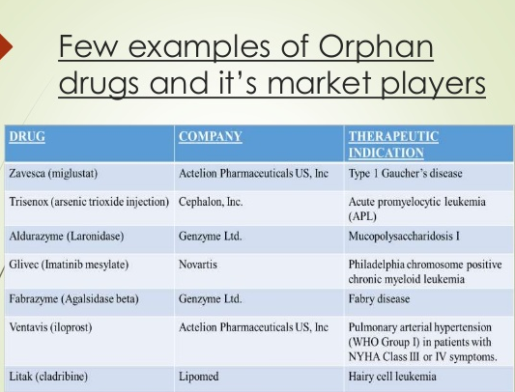

Slide 23
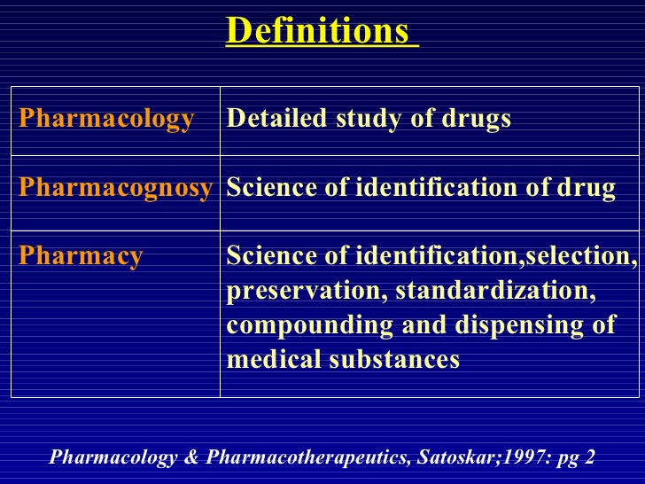
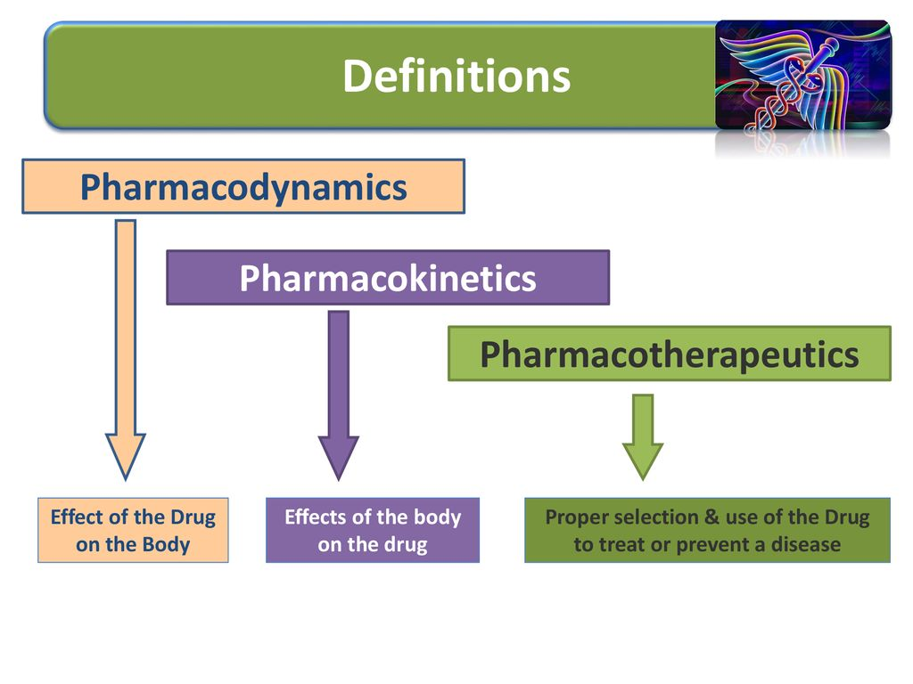
SUMMARY

Slide 24
Activity
MCQ 1
An orphan drug is :
A very cheap drug
A drug which has no therapeutic use
A drug used for the treatment and prevention of rare disease
A drug which is banned by WHO
A drug which is easily available OTC

Slide 25
Activity
MCQ 2:
Practical application of the knowledge of pharmacology in the prevention and treatment of diseases is called
Pharmatherapeutics
Pharmacognosy
Pharmacy
Toxicology
Pharmacokinetics

