Slide 1
NOMENCLATURE, SOURCES OF DRUGS
Prof Dr Ulfat Sultana
Deptt of Pharmacology
Muhammad College of Medicine

Slide 2
Objectives :
At the end of the discussion , you shall be able to :
Describe how the drugs are named i-e chemical , generic /official and trade names of the drugs with examples .
Discuss sources of drugs with examples.

Slide 3
Describe genetic engineering source of drugs with examples.
Discuss important active principles of drugs with examples.

Slide 4
Nomenclature , Sources
And Active Principles of drugs .
Professor Dr Ulfat Sultana
Pharmacology Department,
Muhammad College of Medicine

Slide 5
Mcq’s
A 5-year-old boy brought to ER in state of confusion . On examination pulse is irregularly irregular , bradycardia and skin is dehydrated – ECG shows arrythmia . Labs show hypokalemia . Mother gives history of child having habit of eating leaves. Which of the following is source of drug responsible for this condition .
A- belladona leaves
B- chinchona bark
C-digitalis leaves
D- senna leaves
E-Dhatura leaves

Slide 6
MCQ’S
Aspirin is an example of which nomenclature
A-chemical name
B-Generic name
C- code name
D- proprietary name
E-brand name

Slide 7
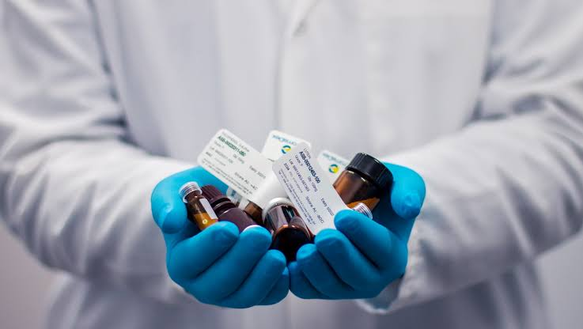
drugs
A substance used for prevention , diagnosis or treatment of disease .

Slide 8
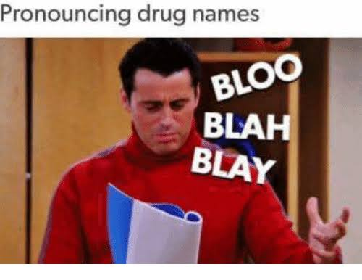
Nomenclature of drugs
Term implies that there are several names that can be used to identify a drug .

Slide 9
A drug can have :
Chemical Name
Generic / Official Name
Trade / Proprietary Name
Code Name

Slide 10
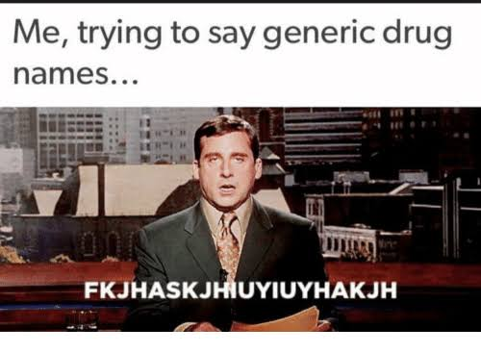

Slide 11
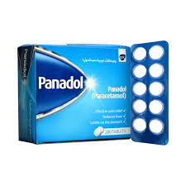
Ever used it before ?

Slide 12
Chemical name
Generic name
Trade
Name
N-Acetyl-p-amino phenol
Paracetamol
Panadol

Slide 13
Chemical name :
Drugs named on the basis of their chemical structure . These are mostly
Lengthy
Complicated
Hard to remember
EXAMPLE :
N-acetyl-p-amino-phenol (Panadol)

Slide 14
GENERIC /OFFICIAL/approved NAME :
Names written in pharmacopoeias and approved by official bodies .
Usually represent prototype drug .
EXAMPLE
metoprolol , atenolol , sotalol follows their prototype called propranolol

Slide 15
TRADE/ PROPRIETARY/ brand NAME :
Name given by manufacturer/ pharmaceutical company to a particular formulation of a substance .
Example :
Amoxil for amoxicillin

Slide 16
Code name :
This is a convenient means of referring to the compound before approving it .
Example :
A letter and a number : The Letter represents research laboratory involved and number is arbitrarily designed ---- SH578
A Letter derived from portion of chemical name – Tpa for tissue plasminogen avtivator

Slide 17
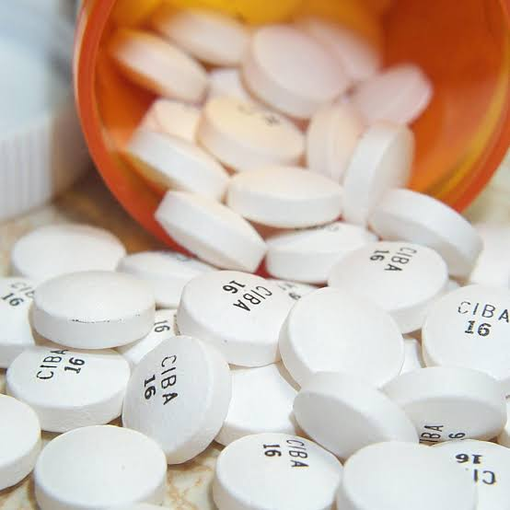

Slide 18
Sources of drugs :
There are two main categories of sources of drug
1- Natural
2- Syntheic

Slide 19
Natural Sources
Plants
Animals
Microbes
Minerals

Slide 20
Natural source of drugs
1- PLANTS :
Major natural source of drugs .
Active principle is localized in one or more parts of the plant body such as roots , leaves , bark etc .

Slide 21
example
Plants | Active principle | Use
Belladonna | Atropine | Organophosphate poisoning
cinchona | Quinine | Malaria
Digitalis leaves | digoxin | CHF

Slide 22
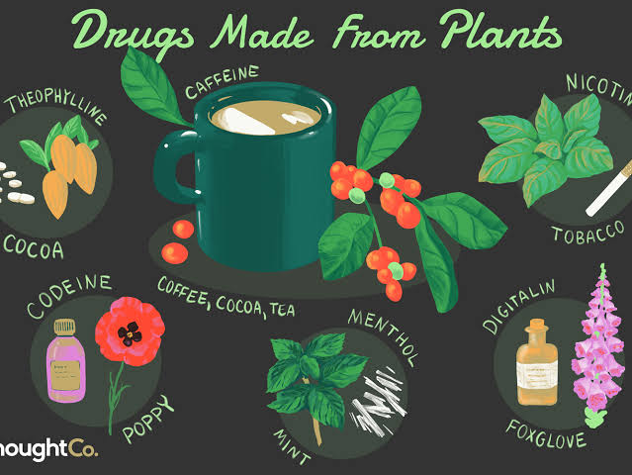

Slide 23
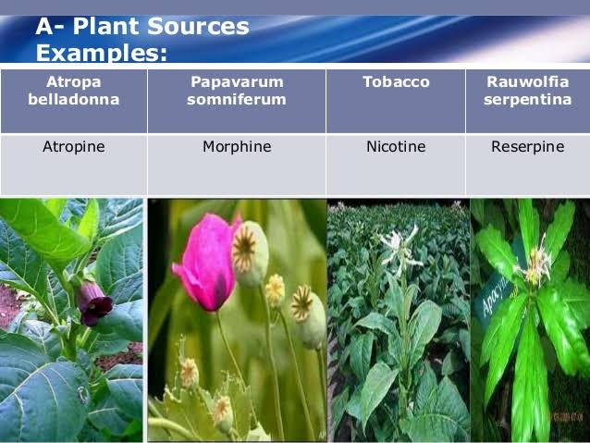

Slide 24
2- Animals :
Various drugs are obtained from animals .
Examples :
Hormones - insulin obtained from pancreas used in treatment of DM .
Vitamins - cod liver oil is a major sources of vitamin A & D .

Slide 25
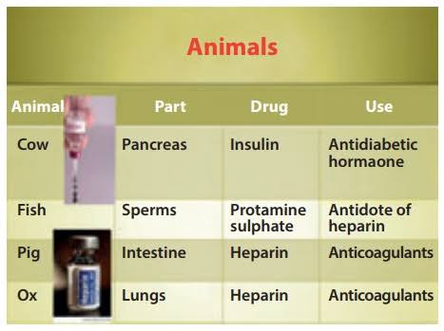

Slide 26
3-Microbes :
Alexander fleming , discovered penicillin in 1929 , using microbes as source .
Examples :
Antibiotics – penicillin
Hormones – insulin from E-coli

Slide 27
4- MINERALS :
Metallic and non metallic sources of drugs include the following :
METALLIC :
Iron used in treatment of IDA .
Mercuric salts for treating syphilis .
NON-METALLIC :
Iodine is used as anti-septic .

Slide 28
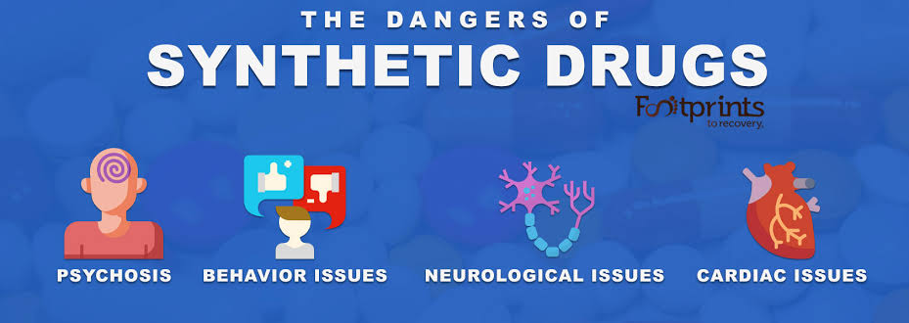
Synthetic sources :
Synthetic drugs are obtained when nucleus from natural source or it’s chemical structure is altered .
> 90 % drugs are obtained from synthetic source

Slide 29
Synthetic Sources
Chemical
Products
Biochemical
Products
Biotechnology based products

Slide 30
1- CHEMICAL PRODUCTS :
These are synthesized from a simple reagents .
It can be either structural copy of natural drug like many antibiotics , alkaloids or it can be a totally new drug .
Economical and high yeild .

Slide 31
2- BIOCHEMICAL DRUGS :
These are obtained from natural resources but are modified synthetically to have desired properties .
EXAMPLE :
Protamine-zinc insulin : zinc is chemically combined with natural products of insulin to increase its duration of effect.

Slide 32
3- BIOTECHNOLOGICALLY BASED DRUGS /
GENETIC ENGINEERING :
Genetic engineering has provided a means of producing animal origin drugs of desired properties with high productivity profile and minimal adverse effects using DNA recombinant technology .
EXAMPLE :
Human insulin by recombinant DNA technology produced on large scale .

Slide 33
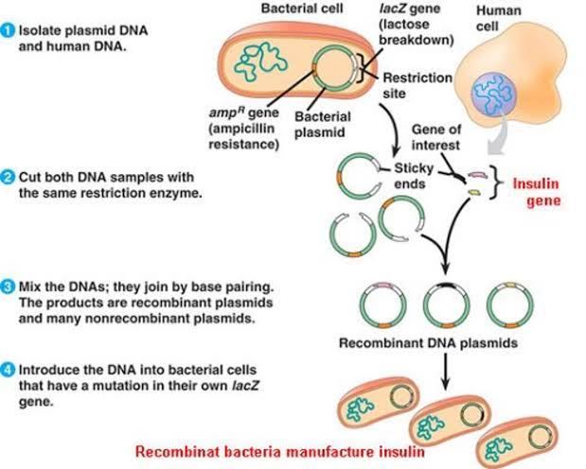

Slide 34
active principle
The constituent of drugs which are biologically active and responsible for the therapeutic action of drugs .
These include :

Slide 35
1- Alkaloids | 11- Waxes
2- Glycosides | 12- Volatile oils
3- Resins | 13- Fixed oils
4- Saponins | 14- Terpinoids
5- Tanins | 15- Enzymes
6- Balsams | 16- Vitamins
7- Carbohydrates | 17- Minerals
8- Amino acids | 18- Hormones
9- Organic acids | 19 - Steroids
10- Gums

Slide 36
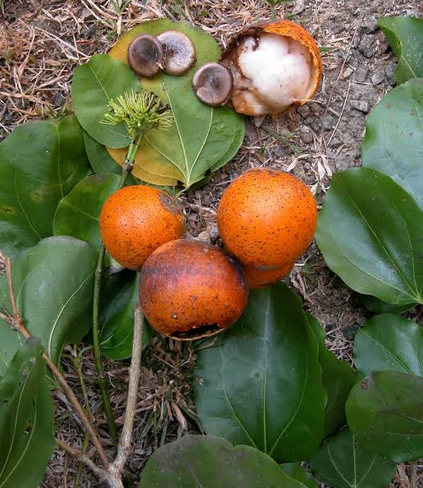
1- Alkaloids
Derived from plants , mostly soild but a few liquids .
Insoluble in water but soluble in alcohol .
Their name ends with “INE” .
EXAMPLE :
1- Strychnine
2-quinine
3-atropine

Slide 37
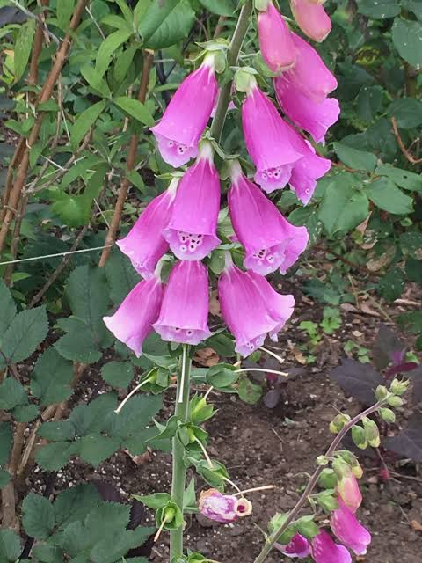
2- GLYCOSIDES :
These are non-nitrogenous organic compounds , neutral in nature .
Consists of two parts – a sugar part (Increase solubility in water) and a non-sugar part (aglycone) .
Ends with “IN”
Example :
1-Digoxin
2- Picrotoxin

Slide 38
3- resins
These are non-absorbable oxidative products of volatile oils .
There are two types :
Simple resins ~ include oleoresins and gums
Ion exchange resins ~ contain anions and cations

Slide 39
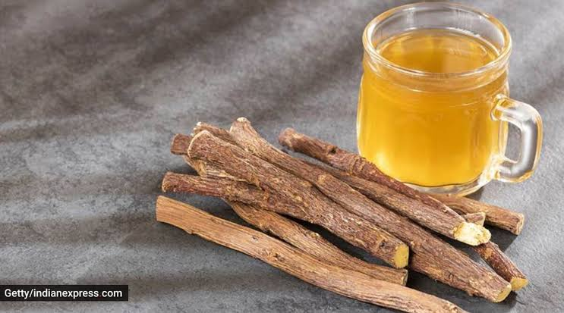
4- saponins :
Complex organic compounds of plant origin , soluble in water and produce soapy aqueous solution .
They are used as emulsifying agents and have hemolytic properties .
Examples :
Licorice
Senega

Slide 40
5- tannins
These are non-nitrogenous compounds .
Soluble in water and alcohol .
They form blue musky color with ferric salts
These are used as astringents i-e precipitate proteins of mucous membrane . The precipitated compound combine with acid to form leather .

Slide 41
6- balsams :
Plant origin .
Resins combine with benzoic or cinnamic acid or both
Combination of oleoresins and balsamic acid .
EXAMPLE :
Tinc. Benzoin Co
Resin of Tolu
Resin of Peru

Slide 42
7-CARBOHYDRATES :
These are mono or polysaccharides like starch or lactose .
May also contain acids , alcohol , gums etc .
These reinforce the body’s immune system
Also used as emollients , protectants and laxatives .

Slide 43
8-Amino acids :
Plant origin .
Help in biosynthesis of proteins .
EXAMPLES :
Hemerocallis fulva which contain adenin , choline , arginine .

Slide 44
9- organic acids :
Plant origin .
Used as anti-inflammatory , anti-septic and anti- flatulent .
EXAMPLES :
Tartaric acid
Citric acid

Slide 45
10- gums :
Exudates of plants .
These are repeating units of polyuroids , sugar and uronic acid .
Used as emulsifying agent and demulcents(relieve irritation of mucous membrane) .
EXAMPLES:
Gum acacia
Gum tragacanth

Slide 46
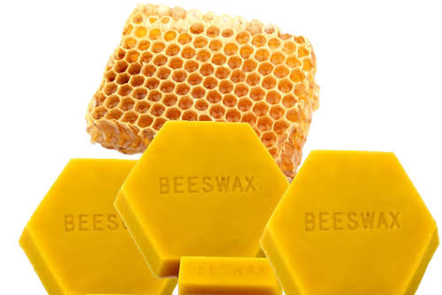
11- waxes :
Esters of fatty acids with monohydric alcohols .
Used in ointments and drugs .
EXAMPLES :
Bee’s wax .

Slide 47
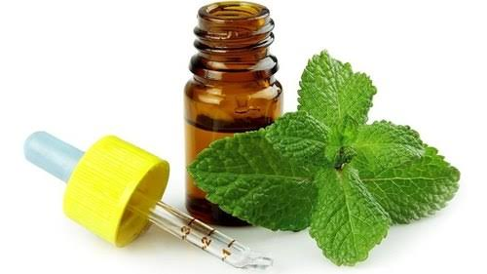
12 – volatile oils/essential oils :
Plants origin , obtained from distillation .
Highly aromatic , impart smell and taste to water when mixed .
Used as carminative , diuretics and counterirritants .
EXAMPLES :
Menthol
thymol camphor

Slide 48
13-fixed oils :
Called fixed oils because they cannot be distilled without being decomposed hence they do not evaporate when exposed .
EXAMPLES :
Castor oil
Olive oil
Cod liver oil

Slide 49
14- terpenoids :
These are the plant products of higher fatty acids .
EXAMPLES :
Hemi , di , triterpinoids and sesquiterpinoids .

Slide 50
15 – enzymes :
Obtained both from animals , plants and microorganisms .
Used for inflammation and digestive disorders .
EXAMPLES :
ANIMAL source ~ papain , diastase .
PLANTS source ~ pepsin , trypsin , lipase .

Slide 51
16 – vitamins :
These take part in metabolism .
EXAMPLES :
ANIMAL SOURCE ~ Vit A , D , E & K (fat soluble)
PLANT SOURCE ~ V it B & C (water soluble )

Slide 52
17 – minerals
Both plant and animal sources .
EXAMPLES :
Iodine in cod liver oil
sodium
Magnesium

Slide 53
18 – hormones :
These are biological agents used for controlling biological activities of living organism .
EXAMPLES :
Inuslin
Growth hormones
Glucagon

Slide 54
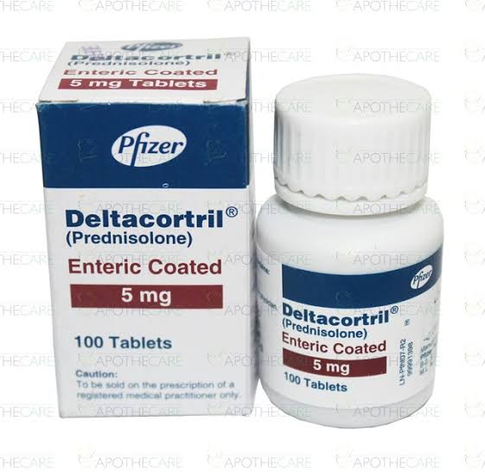
19 – STEROIDS
Like hormones , they help in development & control functions of reproductive system .
EXAMPLES :
Anti-inflammatory function of corticosteroids
Oral contraceptives

Slide 55
THANK YOU

