Slide 1
INTRODUCTION TO PHARMACOLOGY
Professor Dr. Ulfat Sultana
Deptt of Pharmacology
MCM

Slide 2
WHAT IS PHARMACOLOGY
From the Greek Pharmacon(DRUG)
Pharmacology is the science that deals with the study of drugs and their interaction with the living systems.
Two main branches:
Pharmacokinetics:
What body does to the drugs?
Study the fate of drugs once ingested
Includes absorption, distribution, metabolism and excretion of drugs.

Slide 3
Pharmacodynamics
What the drugs do to the body?
Study the mechanism by which drugs act-----
RELATIONSHIP---- dynamics and kinetics
Dosage Regimen
Pharmacokinetics ↓󠇯Absorption, distribution, meta, excretion
Concentration in plasma
Pharmacodynamics ↓
Concentration at the site of action
↓
EFFECTS

Slide 4
PHARMACY
It is the branch of science that deals with the preparation ,preservation, standardization, compounding, dispensing and proper utilization of drugs.
THERAPEUTICS
It is the aspect of medicine concerned with the treatment of diseases.
CHEMOTHERAPY
It deals with the treatment of infectious diseases/ cancer with chemical compounds that cause relatively selective damage to the infecting organism/cancer cells.

Slide 5
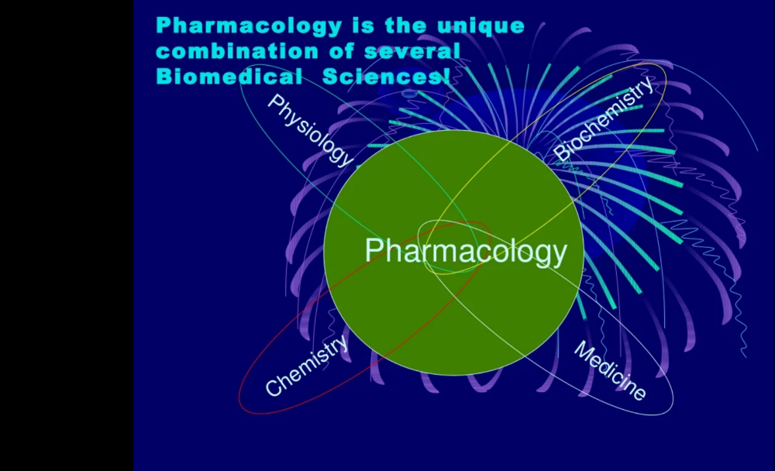

Slide 6
DRUG
French word Drogue-------A dry herb
A single active chemical entity present in a medicine that is used for diagnosis, prevention and treatment of disease.
WHO----in 1966----Drug is any substance or product which is used or intended to be used to modify or explore physiological systems or pathological states for the benefit of the recipient.

Slide 7
DRUG NOMENCLATURE
1.Chemical Name---Chemical name and code name
Describe substances chemically
e.g., para acetylaminophen
2. Non Proprietary name--- it is assigned by competent scientific authority e.g,. United states adopted name(USAN)council, BAN
Paracetamol
3. Proprietary name----it is given by the drug manufacturers. brand names are short and easy to recall. Brand names can also be used in prescriptions. Disprin is a brand name of aspirin: Calpol for Paracetamol...

Slide 8
SOURCES OF DRUGS
Plant Sources-------- Morphine, Digoxin, Atropine, Quinine
Animal source------- Insulin, Heparin.
Minerals -------------- liquid paraffin, magnesium sulfate
Micro organisms---- Bacteria and Fungi---Penicillin. Streptomycin
Synthetic-------------- Analgesics, Hypnotics, anticancer drugs and antimicrobials
Alkaloids-------------- Water soluble salts of water insoluble nitrogenous compounds e.g., atropine
Glycosides------------ Ether like combination of sugar with other organic acids. Acid hydrolysis separates sugar from non sugar moiety.
Oil----------------------- Peanut oil, coconut oil

Slide 9
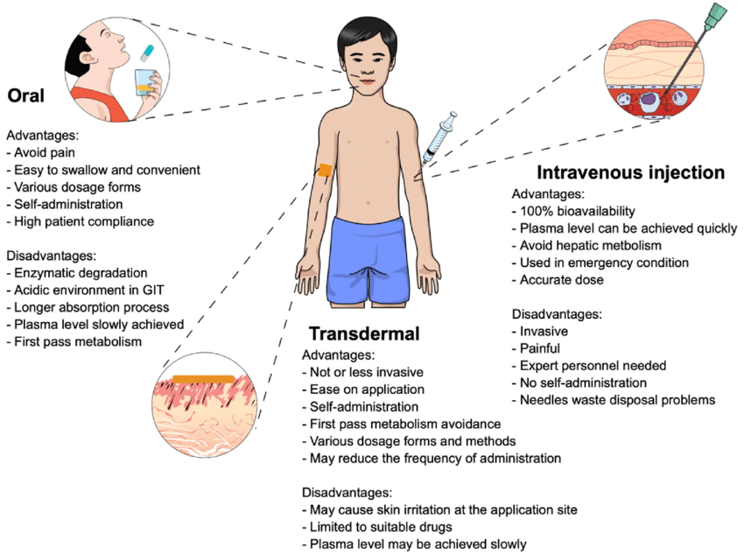
ROUTES OF DRUG ADMINISTRATION

Slide 10
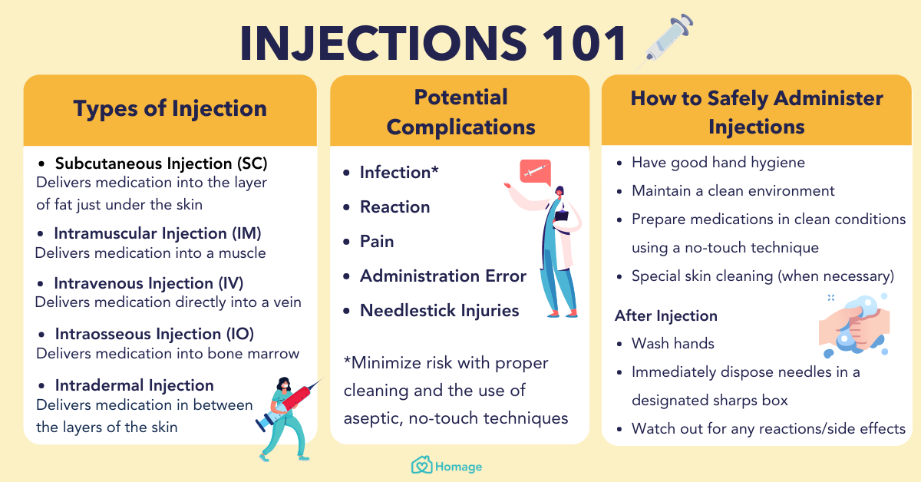

Slide 11


